Slide 1

Ministry/Organization Name/Student Innovation : Ministry of Rural development/MGNREGA/Face Recognition
PS Code : SS584
Problem Statement Title : Develop a tool to assess the quality of captured videos at different remote VSAT terminals.
Team Name : 6 STARS
Team Leader Name : Sree Ragavarthini.M
Institute Code (AISHE) : C-37044
Institute Name : Karpagam College of Engineering
Theme Name : Runtime remote video quality assessment

Slide 2
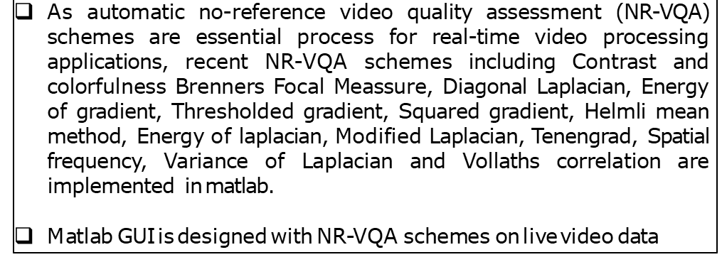
IDEA/APPROACH DETAILS
2

Slide 3
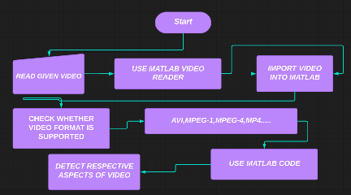
flowchart

Slide 4
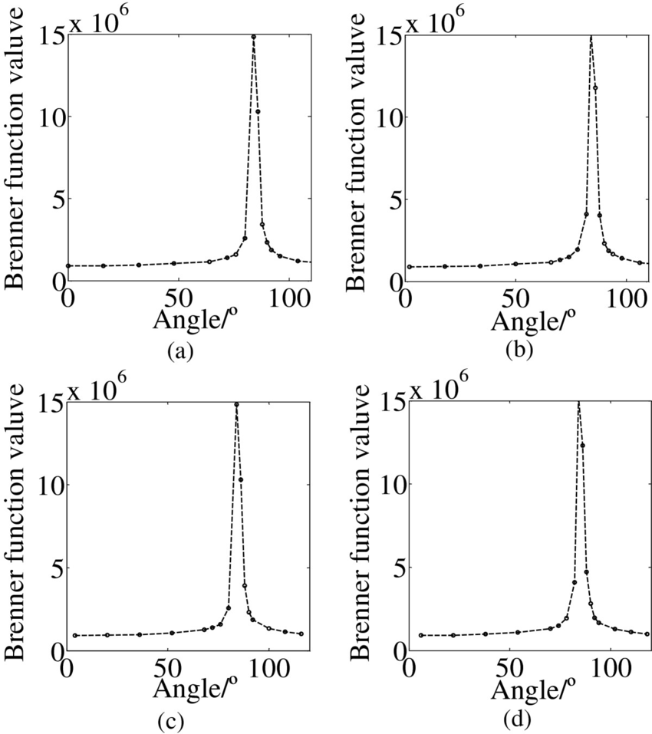
VIDEO QUALITIES
BRENNER
It gives accuracy measure of video.
It extract the gradient information by calculating the gray difference between two adjacent pixels.
The Brenner function score is a measure of the texture in the image.
An in-focus video has a high Brenner function score, and contains texture at a smaller scale than an out-of
focus image.
Conversely, an out-of-focus video has a low Brenner function
score, and does not contain small-scale texture.
function f=Brenner(Image)
[M N] = size(Image);
DH = Image;
DV = Image;
DH(1:M-2,:) = diff(Image,2,1);
DV(:,1:N-2) = diff(Image,2,2);
FM1 = max(DH, DV);
FM1 = FM1.^2;
f = mean2(FM1);

Slide 5
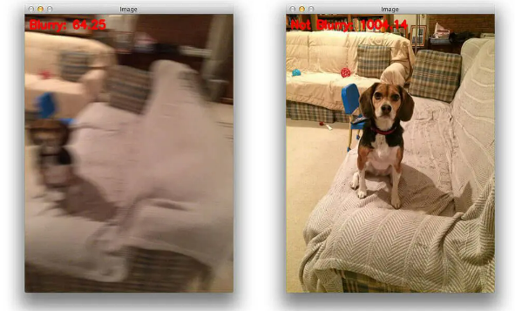
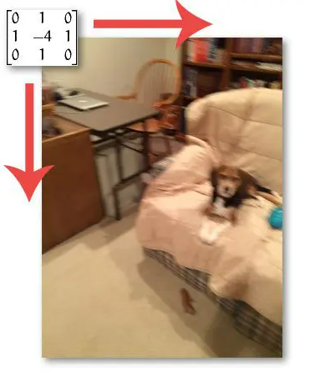
VIDEO QUALITIES
VARIANCE OF LAPLACIAN
It used to compute the amount of blur in an video.
It gives measure of an amount of blur in an video.
function f=Variance_of_laplacian(Image);
LAP = fspecial('laplacian');
ILAP = imfilter(Image, LAP, 'replicate', 'conv');
f = std2(ILAP)^2;

Slide 6
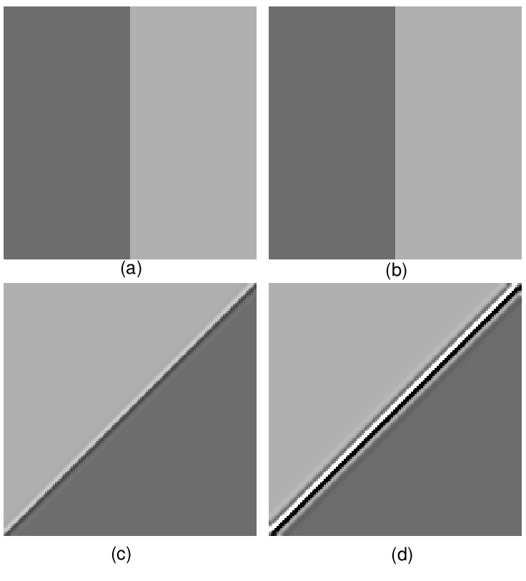
VIDEO QUALITIES
DIAGONAL LAPLACIAN
The diagonal Laplacian focus measure supports developing a focused video considering the diagonal pixels during the selection of focused objects.
function f=Diagonal_laplacian(Image)
M1 = [-1 2 -1];
M2 = [0 0 -1;0 2 0;-1 0 0]/sqrt(2);
M3 = [-1 0 0;0 2 0;0 0 -1]/sqrt(2);
F1 = imfilter(Image, M1, 'replicate', 'conv');
F2 = imfilter(Image, M2, 'replicate', 'conv');
F3 = imfilter(Image, M3, 'replicate', 'conv');
F4 = imfilter(Image, M1, 'replicate', 'conv');
FM20 = abs(F1) + abs(F2) + abs(F3) + abs(F4);
f = mean2(FM20);

Slide 7
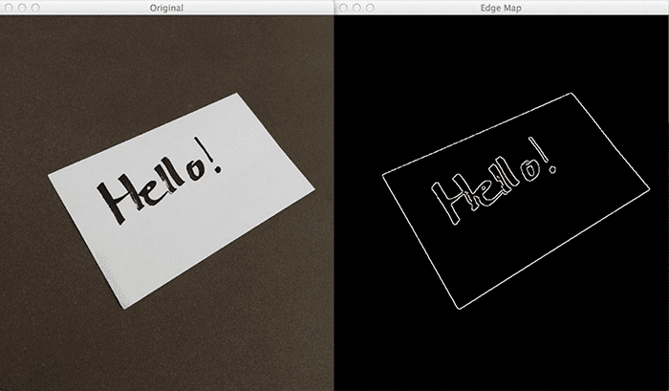
VIDEO QUALITIES
ENERGY OF GRADIENT
Energy of gradient used for detecting edges in video, which allows us to find contours and outlines of objects in videos
Gradient videos are even used to construct saliency maps, which highlight the subjects of an video
A saliency map is a way to measure the spatial support of a particular class in each video.
The main application of image gradients lies within
edge detection.
function f=Energy_of_gradient(Image)
Ix = Image;
Iy = Image;
Iy(1:end-1,:) = diff(Image, 1, 1);
Ix(:,1:end-1) = diff(Image, 1, 2);
FM11 = Ix.^2 + Iy.^2;
f = mean2(FM11);

Slide 8

VIDEO QUALITIES
THRESHOLD GRADIENT
It counts no of pixels according to video's brightness.
Thresholding, manually supply parameters to segment the video
This works extremely well in controlled lighting conditions where we can ensure high contrast between the foreground and background of the video.
function f=Threshold_gradient(Image)
Th = 0;
Ix = Image;
Iy = Image;
Iy(1:end-1,:) = diff(Image, 1, 1);
Ix(:,1:end-1) = diff(Image, 1, 2);
FM12 = max(abs(Ix), abs(Iy));
FM12(FM12<Th)=0;
f= sum(FM12(:))/sum(sum(FM12~=0));

Slide 9
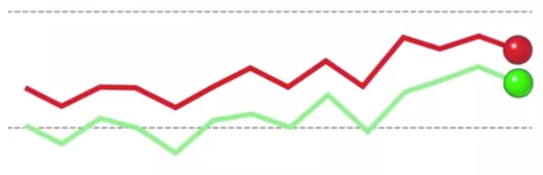
VIDEO QUALITIES
VOLLATHS CORRELATION
It gives the focus of video pixel by pixels basis.
Robust against noise and efficient computationally.
It’s main application is autofocus and autocorrelation of the image.
Autofocus refers to the ability of a camera or optical system to focus automatically.
Autocorrelation is a mathematical representation of the degree of similarity between a given time series and a lagged version of itself over successive time intervals.
But autocorrelation uses the same time series twice: once in its original form and once lagged one or more time periods.
function f=Vollaths_correlation(Image);
Image1 = double(Image);
I1 = Image1; I1(1:end-1,:) = Image1 (2:end,:);
I2 = Image1; I2(1:end-2,:) = Image1(3:end,:);
Image1 = Image1.*(I1-I2);
f = mean2(Image1);

Slide 10
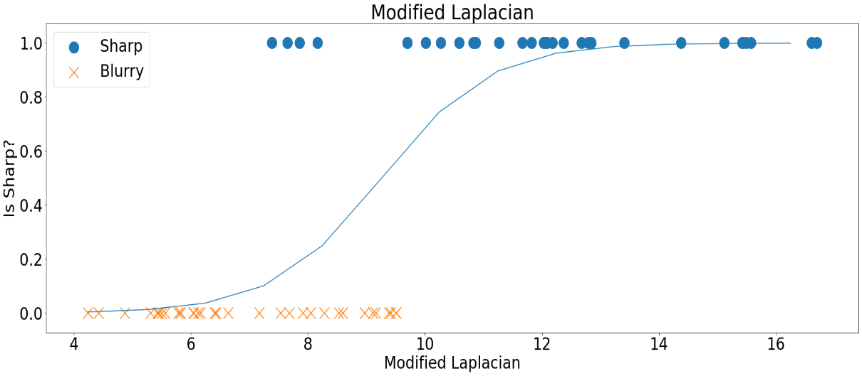
VIDEO QUALITIES
MODIFIED LAPLACIAN
The Modified Laplacian method explores the Laplacian operator in a different fashion.
Instead of looking at the variance, it looks at the absolute values of the filtered image.
The interpretation is that, in sharper images, we might see, on average, large values (both negative and positive) of its Laplacian.
function f=Modified_laplacian(Image)
M = [-1 2 -1];
Lx = imfilter(Image, M,'replicate', 'conv');
Ly = imfilter(Image, M','replicate','conv');
FM18 = abs(Lx) + abs(Ly);
f = mean2(FM18);

Slide 11
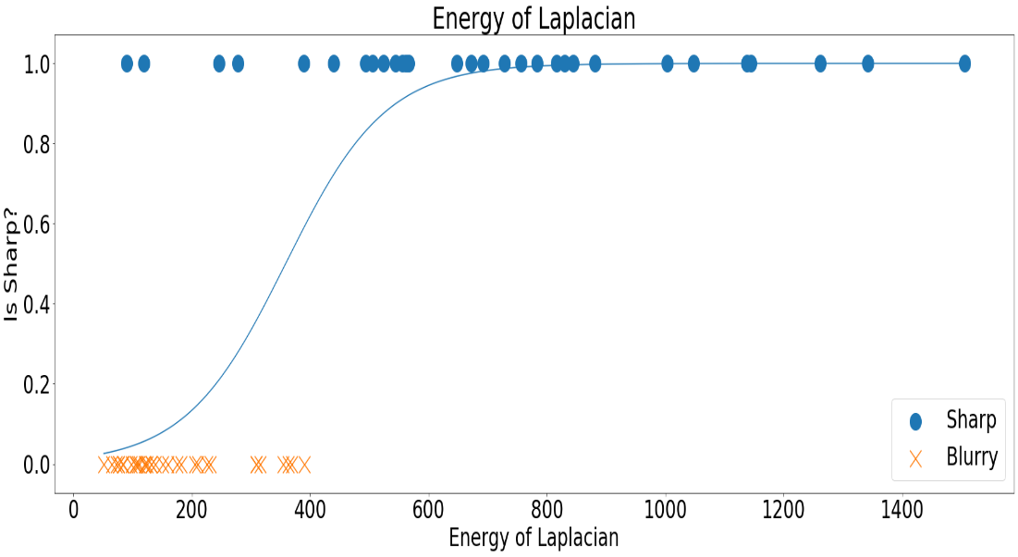
VIDEO QUALITIES
ENERGY OF LAPLACIAN
The Energy of the Laplacian is fairly similar in strategy to the Modified Laplacian.
It explores the fact that the Laplacian of sharp images, when squared, will produce larger values than ones from blurry images.
function f=Energy_of_laplacian(Image)
lap = fspecial('laplacian');
fm17 = imfilter(image,lap, 'replicate’,'conv');
f = mean2(fm17.^2);

Slide 12
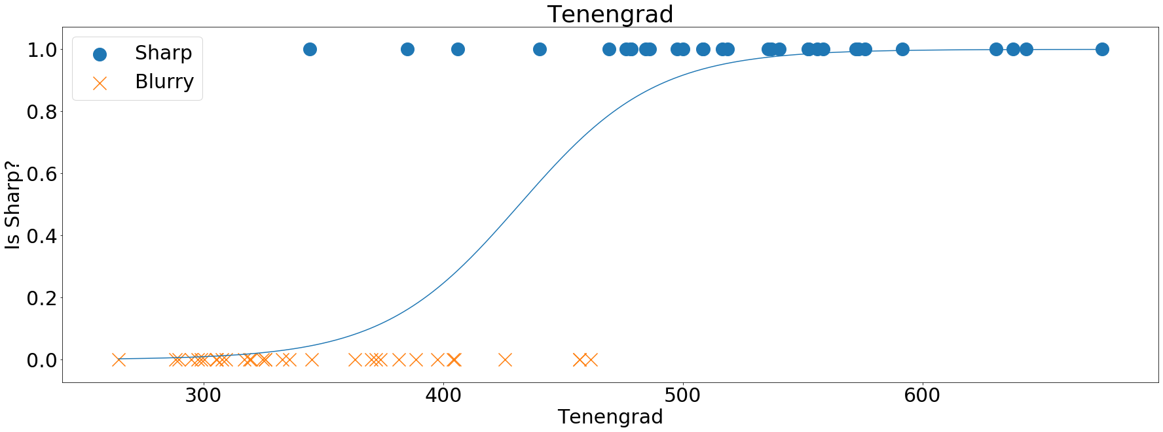
VIDEO QUALITIES
TENENGRAD
It sums the square of all the magnitudes greater than a threshold.
The Tenengrad builds on the fact that, on average, sharper images will produce larger gradient magnitudes when compared with blurry images
function f= Tenengrad(Image)
Sx = fspecial('sobel');
Gx = imfilter(double(Image),Sx,'replicate’,'conv');
Gy = imfilter(double(Image),Sx,'replicate’, 'conv');
FM23 = Gx.^2 + Gy.^2;
f = mean2(FM23);

Slide 13
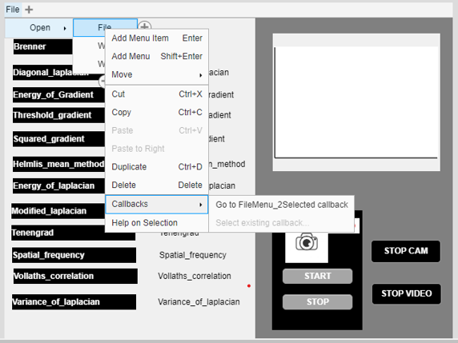
IMPLEMENTATION OF GUI
ADDING CALLBACK TO FILE
Reading vedio from User:
[fileName,pathName]=uigetfile('*.*');
filePath=strcat(pathName,fileName);
vidObj = VideoReader(filePath);
co=1;
while hasFrame(vidObj)
co=co+1;
vidFrame = readFrame(vidObj);
imshow(vidFrame,'parent',app.VIDEO_CARD);
vidFrame=rgb2gray(vidFrame);

Slide 14
ADDING CALLBACKS TO MATHEMATICAL FUNCTIONS:
app.BrennerLabel.Text=num2str(Brenner(vidFrame));
app.Diagonal_laplacianLabel_2.Text=num2str(Diagonal_laplacian(vidFrame));
app.Energy_of_GradientLabel_2.Text=num2str(Energy_of_gradient(vidFrame));
app.Threshold_gradientLabel_2.Text=num2str(Threshold_gradient(vidFrame));
app.Squared_gradientLabel_2.Text=num2str(Squared_gradient(vidFrame));
app.Helmlis_mean_methodLabel_2.Text=num2str(Helmlis_mean_method(vidFrame));
app.Energy_of_laplacianLabel_2.Text=num2str(Energy_of_laplacian(vidFrame));
app.Modified_laplacianLabel_2.Text=num2str( Modified_laplacian(vidFrame));
app.TenengradLabel_2.Text=num2str(Tenengrad(vidFrame));
app.Spatial_frequencyLabel_2.Text=num2str(Spatial_frequency(vidFrame));
app.Vollaths_correlationLabel_2.Text=num2str(Vollaths_correlation(vidFrame));
app.Variance_of_laplacianLabel_2.Text=num2str(Variance_of_laplacian(vidFrame));

Slide 15
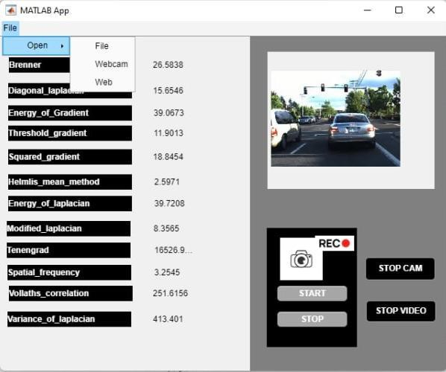
Graphical User Interface
Menu option ,helps to select between real time or existing videos
Video player
Menu driven
options
Web cam video
recording
Stop real time and
existing video
Mathematical Functions
Corresponding Mathematical values

Slide 16
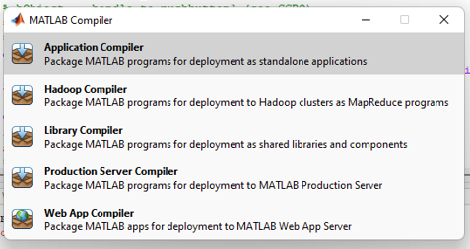

CONVERTING MATLAB FILE INTO EXECUTABLE FILE:
Matlab have a Inbuild method to converting the matlab file to exe file named deploytool .

Slide 17
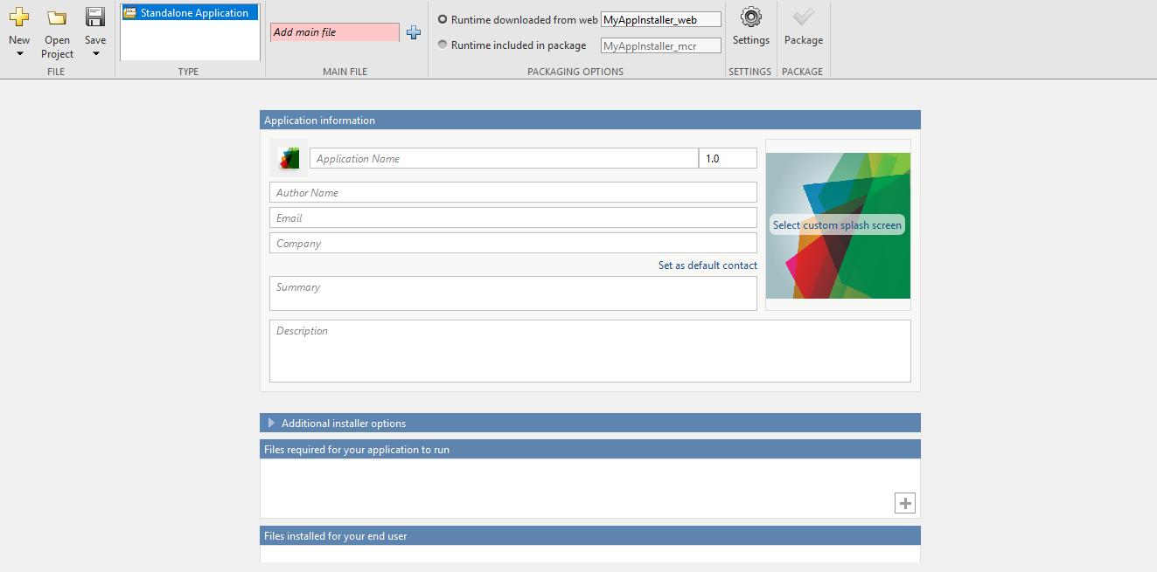
Application Complier

Slide 18
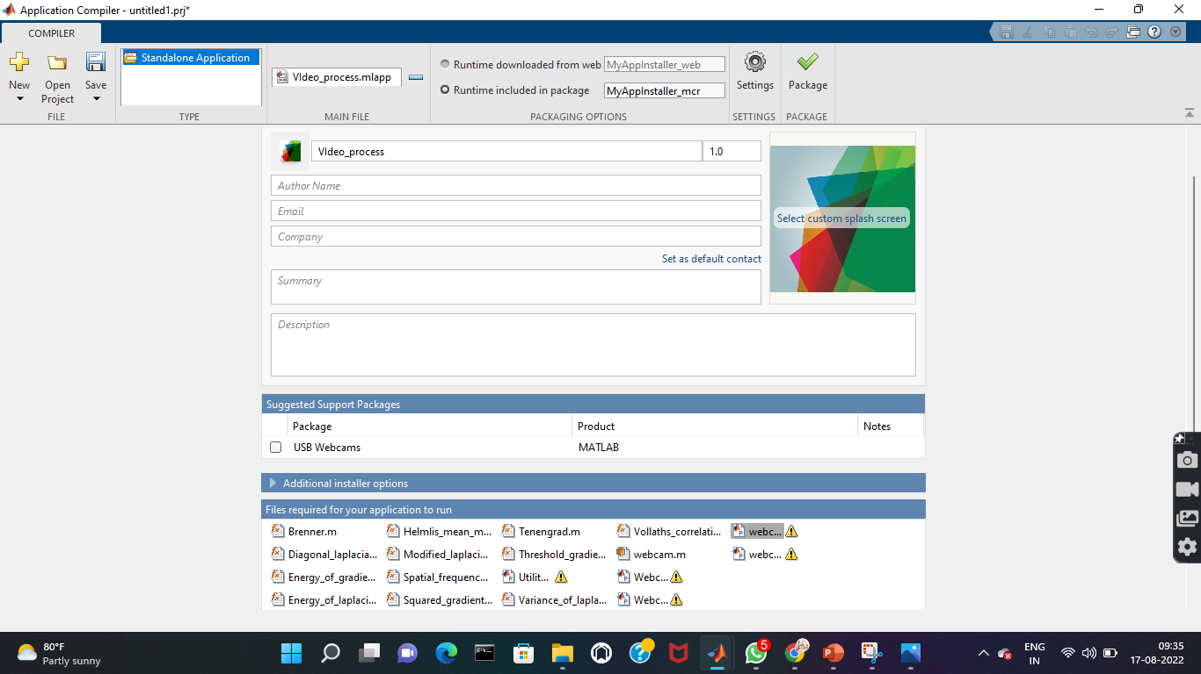
APPLICATION COMPILER
Main file
(GUI)
Main file
(gui file)
Executable file name
Executable file name
Sub files needed
For execution
Sub files needed
For execution

Slide 19
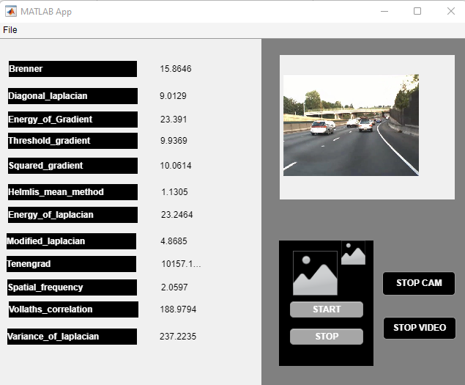
WITH MATLAB
WITHOUT MATLAB

Slide 20
Team Member Details
Team Leader Name: Sree Ragavarthini .M
Branch (BE):
Team Member 1 Name: Kalaiarasi .S
Branch (BE):
Stream ( CSE ):
Year (II):
Stream (CSE):
Year (II):
Team Member 2 Name: Dhanuvarshini.C
Branch (BE):
Team Member 3 Name: Niranjanaa.A
Branch (BE):
Team Member 4 Name: Harini. R
Branch (BE):
Stream (CSE):
Year (II):
Stream (CSE):
Year (II):
Stream (CSE):
Year (II):
Team Member 5 Name: Tanush K
Branch (BE): Stream (CSE):
Team Mentor 1 Name: Vinodhini
Year (II):
Category (Academic): Technical Support Engineer (company: Fortinet technologies india pvt ltd)
Expertise (AI/ML/Blockchain etc): Image Processing,Networking
Domain Experience (in years):

Slide 21
THANK YOU

